Slide 1
SECURITY INFORMATION AND EVENT MANAGEMENT
Mentor – Mr. Jatin Sethi
Bineek Raja, Vikash Anand, Vandana Sharma, Mohit Pandey
B-Tech CSE BFSI – 7th Semester

Slide 2
Abstract
Security information and event management (SIEM) technology supports threat detection and security incident response through the real-time collection and historical analysis of security events from a wide variety of event and contextual data sources. The core capabilities of SIEM technology are a broad scope of event collection and the ability to correlate and analyze events across disparate sources. There is a need to provide cost effective open source application that can provide threat detection through real time analysis of security alerts generated by network components which would be helpful for small organisations.
This application will provide real-time monitoring, correlation of events, notifications, console views and provides long-term storage as well as analysis, manipulation based on reporting of log data and security records.

Slide 3
Introduction
Security information and event management (SIEM) software products and services combine security information management (SIM) and security event management (SEM). They provide real-time analysis of security alerts generated by network hardware and applications.
The segment of security management that deals with real-time monitoring, correlation of events, notifications and console views is known as security event management (SEM). The second area provides long-term storage as well as analysis, manipulation and reporting of log data and security records of the type collated by SEM software, and is known as security information management (SIM).
The term security information event management (SIEM), coined by Mark Nicolett and Amrit Williams of Gartner in 2005,
The product capabilities of gathering, analyzing and presenting information from network and security devices
Identity and access-management applications
Vulnerability management and policy-compliance tools
Operating-system, database and application logs
External threat data
A key focus is to monitor and help manage user and service privileges, directory services and other system-configuration changes; as well as providing log auditing and review and incident response.

Slide 4
Literature Review
SIEM or Security Information and Event Management is defined as a complex set of technologies brought together to provide a holistic view into a technical infrastructure. The SIEM gives you a holistic, unified view into not only your infrastructure but also workflow, compliance and log management. A SIEM can provide a multitude of capabilities and services efficiently.
At its core, a SIEM provides:
Event and Log collection: This may come in many forms, especially with in-house applications.
Layered Centric Views or Heterogeneous: This is usually in the form of dashboards or “views,” referred to as a bird’s-eye view.
Normalization: a two-part function. This includes translating computerized jargon to readable data to be displayed, and mapping data to user- or vendor-defined classifications/characterizations. This is sometimes referred to as “field mapping.”
Correlation: This essentially gives the data context and forms relationships based on rules, architecture and alerts. This should be either historical or real-time.
Adaptability (Scalable): This dumbs down to being able to speak the language regardless of source vendor, format, type, change or compliance requirement.
Reporting and Alerting: This may be used to not only show value to executives but also provide automated verification of continuous monitoring, trends and auditing. Some would argue that the auditing aspect is an essential function but the SIEM alone does nothing – like a retired general with no troops or a SQL instance with no tables or data.
Log Management: Allowing the capability for storing event and logs into a central location, while also allowing the application of compliance storage or retention requirements. (Again, many would argue this is a separate function, and I would disagree.)

Slide 5
Problem Statement
There is a need to provide cost effective open source application that can provide threat detection through real time analysis of security alerts generated by network components which would be helpful for small organisations.

Slide 6
Objective
To develop an application which can provide real-time monitoring, correlation of events, notifications, console views and provides long-term storage as well as analysis, manipulation and reporting of log data and security records.

Slide 7
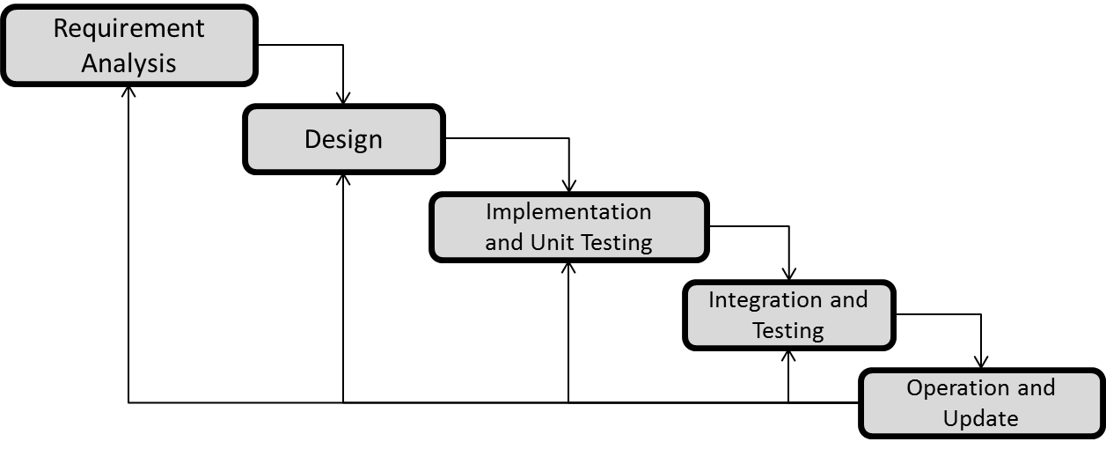
Methodology
We are using ITERATIVE WATERFALL MODEL due to large data size and complexity of our project.

Slide 9
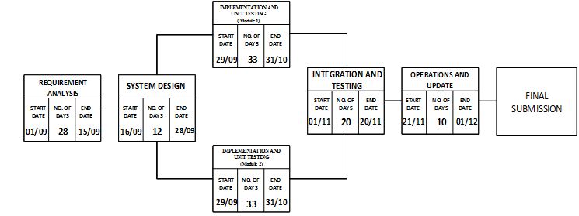
Pert Chart

Slide 10
References
“Successful SIEM and Log Management Strategies for Audit and Compliance” Swift, David, 4 November 2010
“Magic Quadrant for Security Information and Event Management” Bussa, Toby & Kavanagh, Kelly, 10 August 2016

Slide 11
Thankyou

